Slide 1
Bank Term Deposit Dataset
Sree Jignash Reddy Bonthu

Slide 2
Dataset
ML Marathon Dataset by Azure Developer Community
Parihar, D. (2022, October 13). ML Marathon dataset by Azure Developer Community. Kaggle. Retrieved November 8, 2022, from https://www.kaggle.com/datasets/dev523/ml-marathon-dataset-by-azure-developer-community?select=data.csv
16 predictor variables
9 categorical
job, marital, education, default, housing, loan, contact, month, poutcome
7 numeric
age, balance, duration, campaign, day, pdays, previous
1 outcome variable (categorical) - deposit

Slide 3
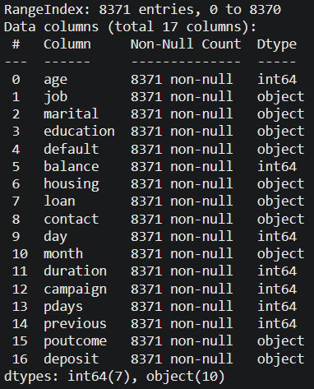
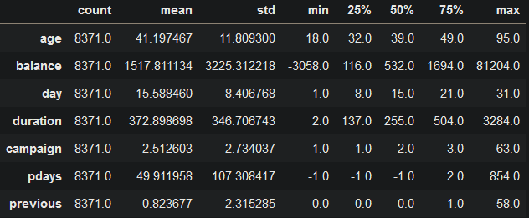
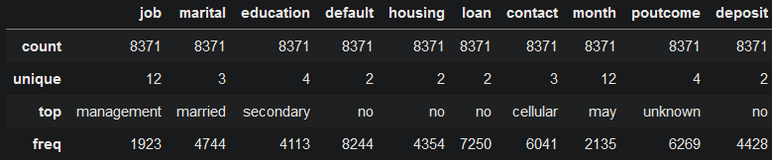
Dataset
Numerical Data
Categorical Data

Slide 4
Models
Logistic Regression
Easier to implement
Scales well on an industry level
Random Forest Classification
Can better capture complex relationships
Better with handling larger number of categorical variable than LR

Slide 5
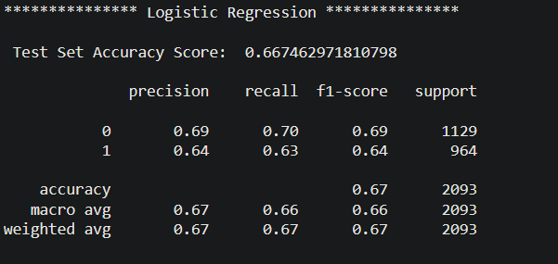
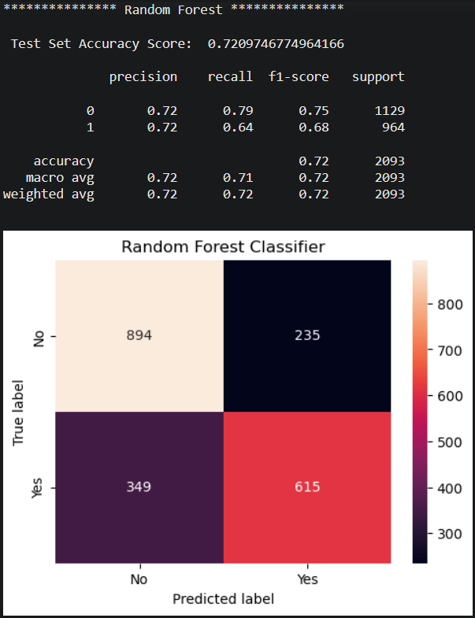
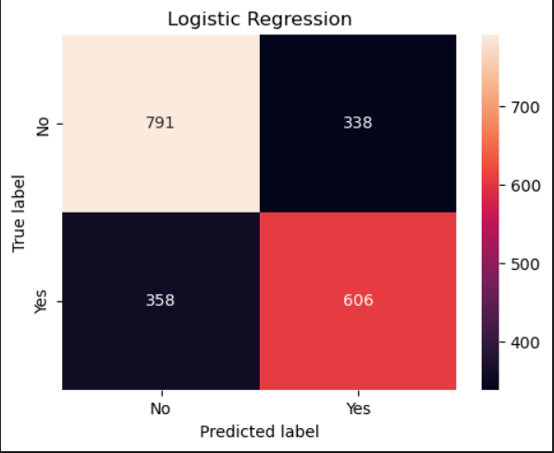
LR vs RFC

Slide 6
Improving Predictive Power
Having more data
Hyperparameter tuning using GridSearch, RandomSearch, etc
Better feature engineering and selection
Cross-validating through multiple models

